Slide 1
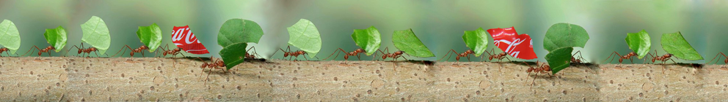
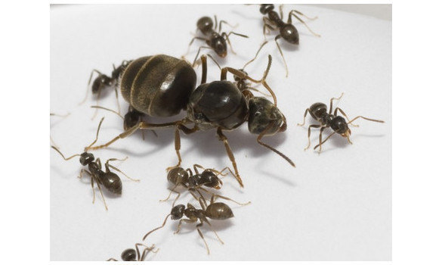



Tout un monde de plastique
Impact des phtalates sur la physiologie des fourmis Lasius niger
Impact of phthalates on the physiology of the ant Lasius niger
Virginie Cuvillier

Slide 2
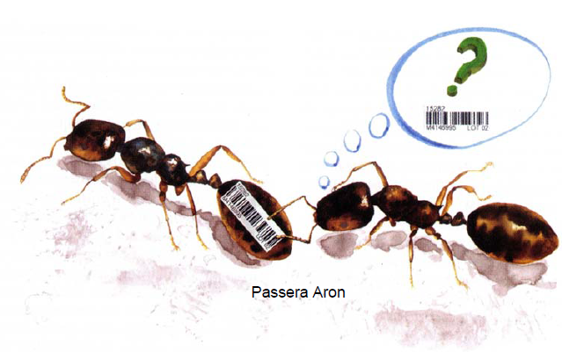
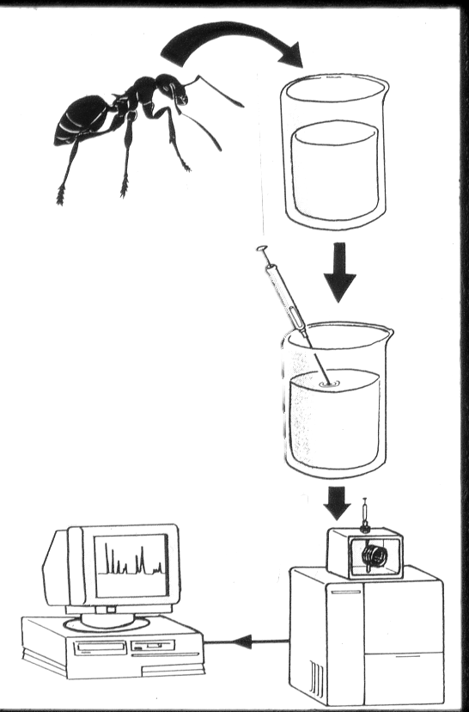
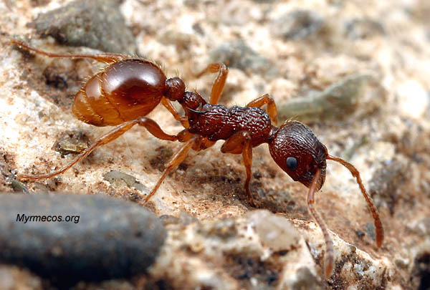
C25:1
« Universal contaminants »
Phthalate
C25
squalène
3C25

Slide 3
Phthalates: Universal contaminants
widely used as important additives which confer flexibility to plastic matter (PVC and other polymers – food packaging, building materials, home furnishings, toys, child care articles, clothing, car interiors, cosmetics, paints and resins, adhesives, printing inks, medical disposals…)
may constitute up to 50 per cent of the total weight of PVC plastics and produced in extremely large volumes by the plastic industry (first use in the 1920s)
released in the different compartments of our environment during manufacture, utilization and waste disposal (leaching from final product)
bioaccumulate in the aquatic and terrestrial food chain
Notes:
Phtalates = plastifiant produit en masse et libéré dans l’environnement
répartition, taux de contamination études chez les vertébrés et invertébrés agro
Perturbateurs endocriniens
Chez les invertébrés terrestres ?
The diesters of 1,2-benzenedicarboxylic acid (phthalic acid), commonly known as phthalates, are a group of man-made chemicals widely used in industrial applications.
Plasticizers are present in building materials, home furnishings, clothing, food packaging. Di-n-butyl phthalate (DnBP) is used in epoxy resins, cellulose esters and special adhesive formulations. Dimethyl phthalate (DMP) and diethyl phthalate (DEP) are present in cellulose ester-based plastics such as cellulose acetate and butyrate. Di(2- ethylhexyl)phthalate (DEHP) is found in medical disposals and in a number of medicine coatings.
Their world production increased from 1.8 million tons in 1975 to 3 million tons in 2001, the quarter being represented by the DEHP
Bioconcentration factors reported in invertebrates are generally higher than those in vertebrates. As an example, for DEHP , BCFs reported are between 42 and 842 in different sh species, but 3600 for the amphipod Gammarus pseudolimnaueus, 2500 in the mussel Mytilus edulis and up to 5380 in the copepod Acartia tonsa

Slide 4
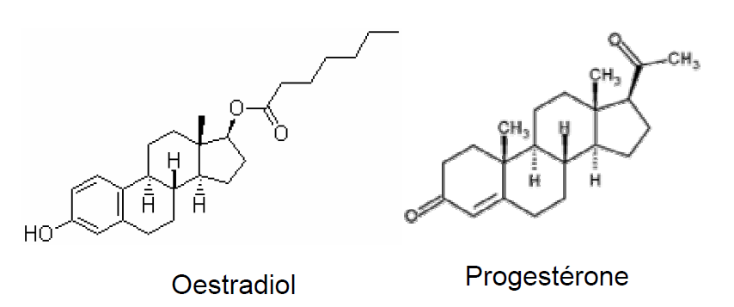
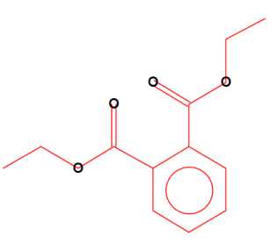
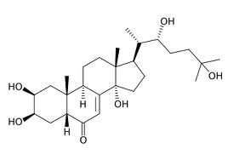
Phthalates: Universal contaminants
In the 1990s: suspected to be involved in endocrine disruption because of anti-estrogenic effects
Main known effects:
Disruption of normal development and reproduction, effects observed in one or more animal species (at least for DEHP, DBP and BBP)
toxicity to kidneys, on repeated exposure (workers, transfused or hemodialysed people)
production of reactive oxygen species (ROS), cellular stress and oxidative damages (→ immunotoxicity)
Link with obesity, insuline resistance, asthma, allergies?
Phthalate
Ecdysone
Notes:
Phtalates – répartition, taux de contamination études chez les vertébrés et invertébrés agro
Perturbateurs endocriniens
Chez les invertébrés terrestres ?
Since the 1990s, these compounds have been suspected to be involved in endocrine disruption such as anti-oestrogen effects, especially in Rodents (Sultan et al., 2001) and also in carcinogenic processes and mutagen induction (Moore et al., 2002).
BBP (and BPA) upregulate the expression of the HSP70 gene, as well as that of the ecdysone receptor gene (EcR) in chironomus riparius larvae
Al-Badry and Knowles (1980) applied DEHP topically, on the venter of abdomen, or by intrathoracic injection to female houseflies (Musca domestica). Mortality was checked after 24 hours of exposure to 20 μg DEHP in acetone (1μl when added topically and in 10% solution when injected), which was equivalent to 1,000 mg DEHP/kg bw. DEHP at this concentration did not have any observed effect on the flies when added alone. When applied simultaneously with various organophosphates, an antagonistic interaction was apparent. However, when DEHP was applied 30 minutes before exposure to an organophosphate, the resulting interaction was synergistic, i.e. DEHP increased the lethal effect of the organophosphate

Slide 5
Phthalates: Universal contaminants
In the 1990s: suspected to be involved in endocrine disruption because of anti-estrogenic effects
In 1996: most commonly occurring phthalic acid esters classified as priority pollutants and endocrine disrupting compounds
In 2001: DEHP listed among the 33 hazardous substances in water, by the European community (Decision no. 2455/2001/CE)
In 2007: DEHP, DBP and BBP no longer permitted in toys and childcare articles in the EU
In 2014-2015: DEHP should be progressively removed from the market, except special authorization
Phthalate
Ecdysone
Notes:
Phtalates – répartition, taux de contamination études chez les vertébrés et invertébrés agro
Perturbateurs endocriniens
Chez les invertébrés terrestres ?
Particularly, the DEHP was listed among the 33 hazardous substances in water, by the European community (Decision no. 2455/2001/CE of November 20, 2001).

Slide 6
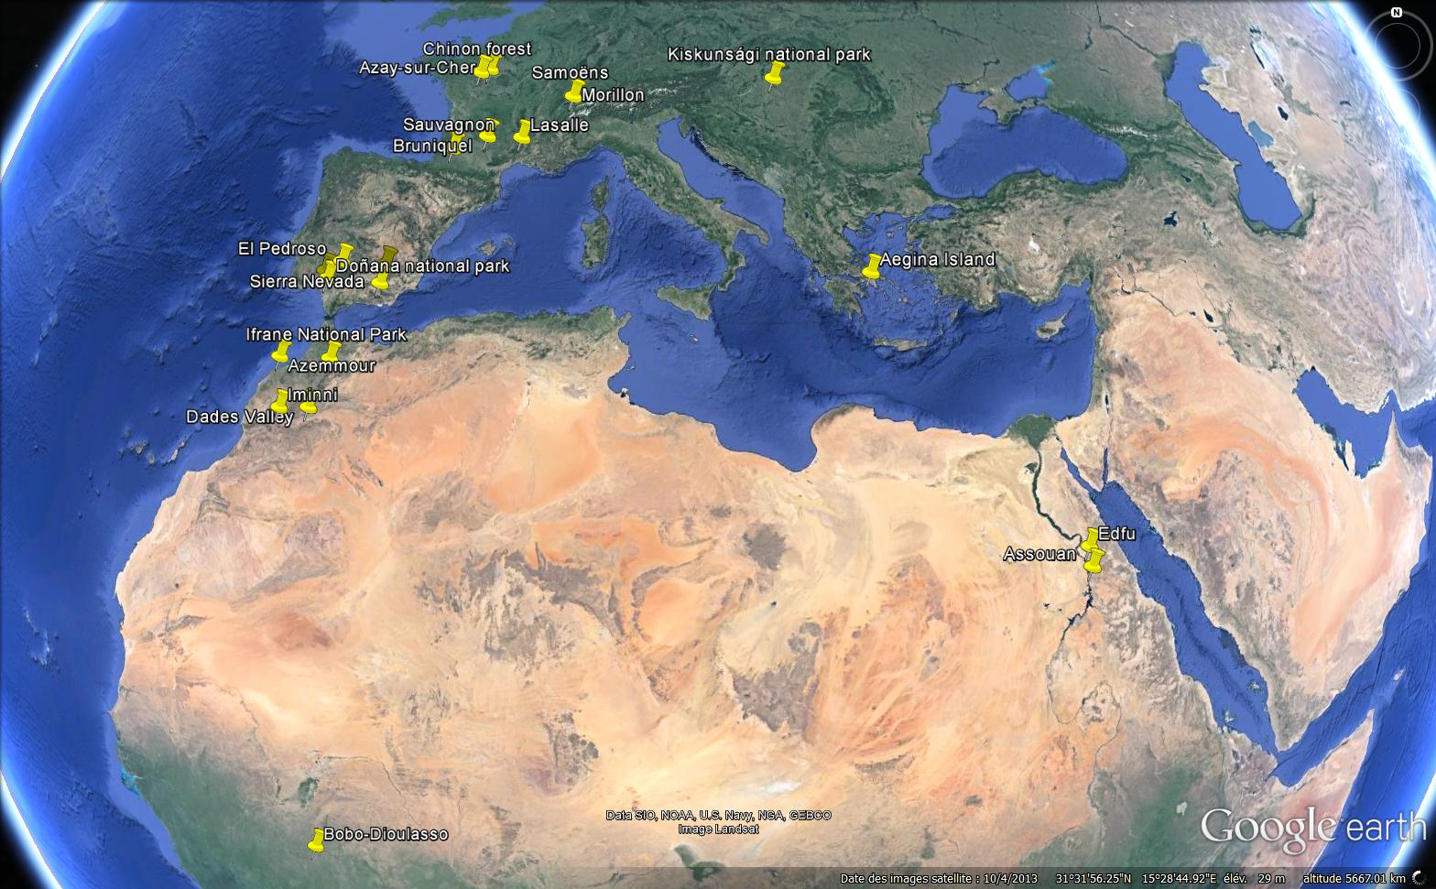
Contamination on all species tested, in all places sampled
from Table S2, Lenoir et al. 2012 Science of the total environment
Notes:
Détection chez plusieurs espèces d’insectes (fourmis, abeille, criquet, coléoptère)
Détection dans tous les sites, même éloignés des zones urbaines

Slide 7
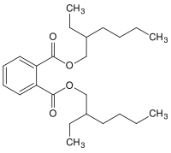
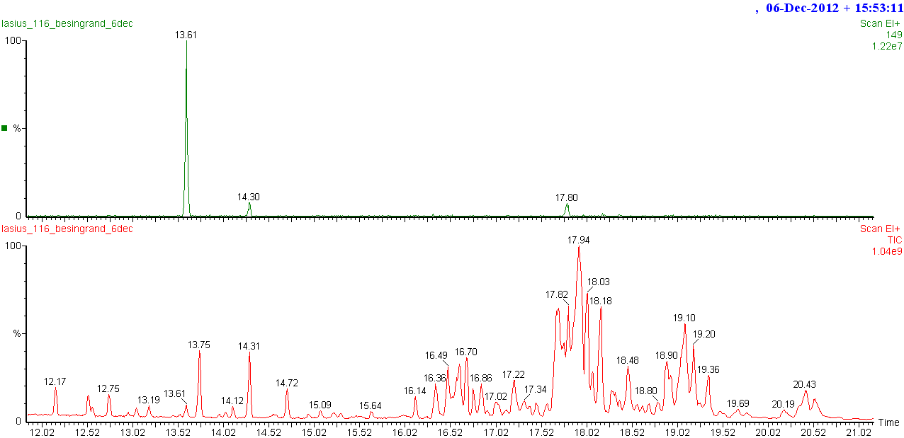
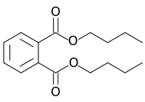
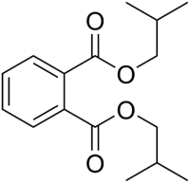
Three main phthalates identified
DEHP
DiEthylHexyl Phthalate
DBP
Dibutyl Phthalate
DiBP
Diisobutyl Phthalate
Major pollutants in aquatic and terrestrial compartments
Notes:
Détection de 3 principaux phtalates, qui correspondent aux principaux polluants retrouvés dans l’environnement
Le phtalate de bis(2-éthylhexyle), phtalate de di-2-éthylhexyle, aussi désigné sous les sigles DEHP (de l'anglais DiEthylHexyl Phthalate) ou DOP (dioctylphthalate), est un phtalate de formule brute C₂₄H₃₈O₄ considéré comme dangereux pour la santé et retiré progressivement du marché européen entre 2014 et 2015, sauf autorisation spéciale.
Dibutyl phthalate (DBP) is a commonly used plasticizer. It is also used as an additive to adhesives or printing inks. It is soluble in various organic solvents, e.g. in alcohol, ether and benzene. DBP is also used as an ectoparasiticide. The use of this substance in cosmetics, including nail polishes, is banned in the European Union under Directive 76/768/EEC 1976. The use of DBP has been restricted in the European Union for use in children's toys since 1999
DIBP is an odorless plasticizer and has excellent heat and light stability. It is the lowest cost plasticizer for cellulose nitrate. DIBP has lower density and freezing point than DBP (dibutyl phthalate). It has similar properties as dibutyl phthalate and can be used as a substitute for it.DIBP is used in nitro cellulose plastic, nail polish, explosive material, lacquer manufacturing and used with methyl methacrylate applications.

Slide 8
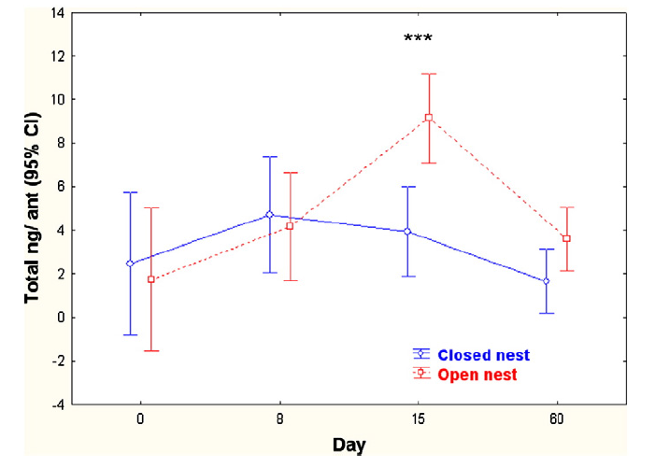
Accumulation of phthalates on ants reared in open nests
Lenoir et al. 2012 Science of the total environment
Notes:
D’où vient cette contamination ?
Lasius niger élevées en laboratoire dans des contenants exempt de phtalates, en nid ouvert ou fermé → accumulation de phtalates sur les fourmis en nid ouvert au bout de 15 jours (n=7 à 20 selon les points)
Après 2 mois : retour aux taux basaux → capacité de régulation ? Métabolisation ?
Ccl : contamination par l’air → phtalates adsorbés sur les particules de l’air

Slide 9
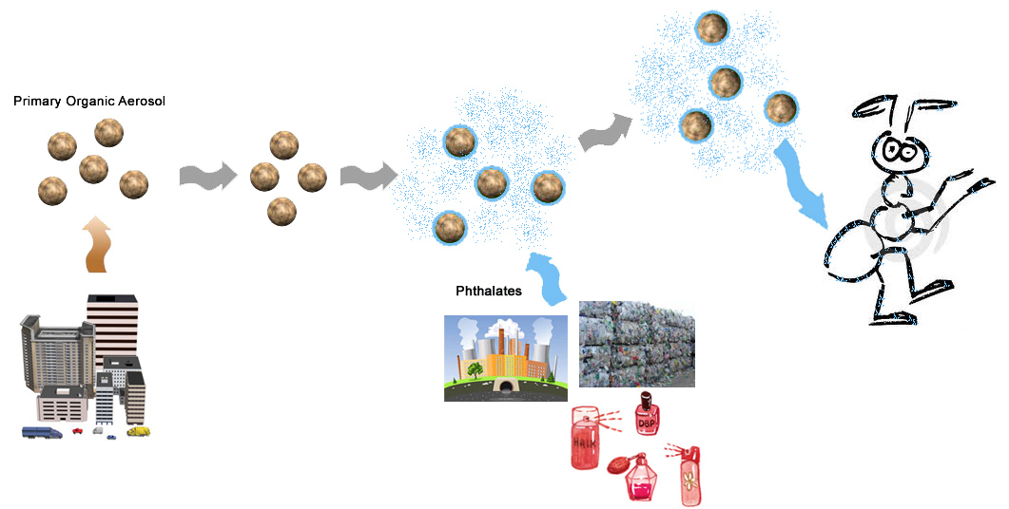
Contamination by phthalates vaporized in the atmosphere or adsorbed on atmospheric particles
Contamination faible mais chronique
(∼ 2ng/ant)
(from Teil et al. 2006)
Notes:
Phtalates dans l’atmosphère : une grosse partie dans la phase vapeur (70% pour le DEHP) et une partie non négligeable adsorbée aux particules (30% pour le DEHP)
Aerosols + phthalates → adsorption sur la cuticule des fourmis
contamination faible (moins de 1 % des composés cuticulaires), à taux assez variable mais chronique
Pbtq : quels effets sur les fourmis ?
comment se comportent ces molécules à la surface de la cuticule des fourmis ?
comment se fait-ils qu’ils restent à bas taux ?

Slide 10
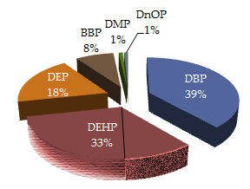
Contamination by phthalates vaporized in the atmosphere or adsorbed on atmospheric particles
?
Contamination faible mais chronique
(∼ 2ng/ant)
(from Teil et al. 2006)
Notes:
Phtalates dans l’atmosphère : une grosse partie dans la phase vapeur (70% pour le DEHP) et une partie non négligeable adsorbée aux particules (30% pour le DEHP)
Aerosols + phthalates → adsorption sur la cuticule des fourmis
contamination faible (moins de 1 % des composés cuticulaires), à taux assez variable mais chronique
Pbtq : quels effets sur les fourmis ?
comment se comportent ces molécules à la surface de la cuticule des fourmis ?
comment se fait-ils qu’ils restent à bas taux ?

Slide 11
Deposited onto the cuticle, phthalates disapear with time
Notes:
Dépôt sur fourmis vivantes de 2µg de composé dilué dans 1µl de methanol → disparition en quelques jours avec retour à des taux basaux
Fig. 1. DEHP quantity decreased with time on inoculated ants (ANOVA F(3,41) = 12.64, P=0.000001) and became non significantly different from controls after 5 days.
DEHP quantities on ants (differences between Control and Treated at Day 0 P = 0.000001, D1 P = 0.00008, D3 P = 0.0007 and D5 P = 0.40 NS)
Fig. 2. DBP quantity decreased rapidly with time (ANOVA F (2,27) = 40.0, P = 0.001), after 48 hours it was not different from control ants.
DBP quantities on ants (differences between Control and Treated at T0 P = 0.000001, T1 P = 0.00005 and T2 P, = 0.59 NS)
Fig. 3. DiBP evolution was comparable to DBP: it decreases rapidly to the control level in two days (ANOVA F(2,25) = 274.4, P = 0.00001).
DiBP quantities on ants (differences between Control and Treated at T0 P = 0.000006, T1 P = 0.00005 and T2 P= 0.86 NS)
When the ants were extracted just after inoculation the mean quantity of phthalates retrieved was generally between 10 to 20% (12% for DEHP, 22% for DBP, and 8% for BBP) but surprisingly 84% for the isomer DiBP.

Slide 12
Same phenomenon with control components
Deuterium-labeled DEHP
BBP, phthalate never found on ants sampled in the wild
Notes:
Même phénomène lorsqu’on réalise des manip control : avec du DEHP marqué qu’on peut aisément identifié par rapport au DEHP « ambiant », avec un phtalate non détecté sur les fourmis en nature, le BBP (Benzyl Butyl Phthalate)
Simple dégradation au cours du temps ou capacité de métabolisation par les fourmis ?
Fig. De-DEHP: We deposited on live ants 50 ng of DEHP-D in 1 µl methanol. On live ants deuterium phthalate quantities decreased rapidly on the cuticle (ANOVA (1,2) 58, F = 10.55, P = 0.0001). After 2 days the quantities do not differ compared to D1.
Fig. BBP disappeared very quickly (ANOVA F(2,21) = 59.8, P = 0.00001), after 24 hours it did not differ from the control ants (7.8 ng/ ant vs. 0, P = 0.35).
BBP quantities on ants (differences between Control and Treated at D0 P = 0.00001, D1 P = 0.35 NS and D2 all values at 0). All control at 0.
Fig. Eicosane: after the deposit of 200 ng of eicosane on the cuticles of live ants, the quantities decreased very rapidly with only 1.19 ng after 24 hours (P = 0.00001) and it decreased again after 2 days (P = 0.01).

Slide 13
Phthalates are actively removed from the cuticle
as other cuticular components
DEHP do not disappear when deposited on dead ants
Phthalates are actively removed from ants’ cuticle
Quantity Eicosane ng/corpse
Same results with Eicosane (n-C20), a control hydrocarbon not found in the cuticular signature of Lasius niger
***
***
General dynamic of cuticular components
***
*
Notes:
Si dépôt de DEHP sur des fourmis mortes : plus de disparition, les taux récupérés restent similaires sur 5 jours et bien supérieurs aux taux de cadavres « contrôles »
Ces différents résultats suggèrent que les phtalates sont activement éliminés de la cuticule des fourmis, et que ce n’est pas une simple dégradation ou évaporation de ces composés synthétiques.
Même manip avec un composé cuticulaire classique, afin de déterminer si on révèle ici une propriété générique de la cuticule des fourmis : Eicosane, hydrocarbure absent de la signature de Lasius niger.
→ Diminution chez les fourmis vivantes mais pas chez les fourmis mortes (même si tendance)
=> Mise en évidence d’une dynamique de renouvellement des composés cuticulaires. Ce phénomène touches les composés « naturels » tels que les HC mais, et c’est plus étonnant, concerne aussi les contaminants synthétiques tels que les phtalates.
Fig. 5 – 2µl of DEHP (200 ng/µl) were deposited on the abdomen of the ants. DEHP quantities on ant corpses after 1, 2, 3 and 5 days. It appeared that DEHP quantities was very stable, it did not decrease (ANOVA F(1,4) = 1.67, P = 0.19) and is always higher than the controls. We retrieved only 2% of the deposited quantity when it was 12% on live ants.
Fig. 6 – Eicosane quantities on live and dead ants after 1 and 2 days. After the deposit of 200 ng of eicosane on the cuticles of live or dead ants, we retrieved similar quantities (20 to 25 ng) on day0 (P = 0.66). On dead ants the quantities did not decrease between D0 and D1 (P = 0.95). Between D1 and D2 there is a tendency to decrease but it is not significant (P = 0.10).
Rq : Fig. 7 – Deuterium DEHP quantities on live and dead ants after 1 and 2 days (ng/ant). All the differences are significant but at D0 (live ants / dead P= 0.22), dead ants at D0 / D1 (P = 0.07) and live ants at D1 / D2 (P = 0.15). In the first day there is no difference between live and dead ants.

Slide 14
So, we know that…
Ants are probably contaminated by atmospheric particules coated with phthalates
Phthalates adsorbe onto the cuticle of ants
High phthalate doses are actively removed from the cuticle by the general cuticular dynamic
Low doses of DEHP, DBP and DiBP remain chronically on ant’s cuticle (∼2 ng/ant ; <1% of cuticular compounds)
? Physiological effect of such contamination ?

Slide 15
Effect on queen fertility?
Experimental exposition of Lasius queens to « ecological » doses of DEHP
3 groups of 10 queens
Pre-treatment phase:
nb of eggs in the nests counted each week for 5 weeks
Treatment phase:
1 group control
1 group treated each week with pure methanol
1 group treated each week with 2ng DEHP diluted in methanol
nb of eggs in the nests counted each week for 5 weeks

Slide 16
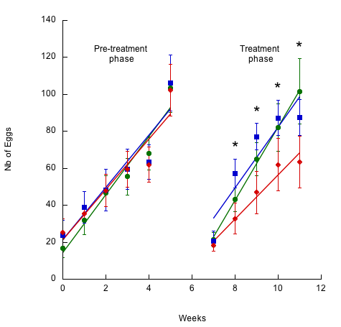
Effect on queen fertility?
control
methanol
DEHP
Queens exposed to DEHP lay fewer eggs
Notes:
Effet sur la fertilité des reines en accord avec ce qui est montré chez d’autres modèles vertébrés et invertébrés.

Slide 17
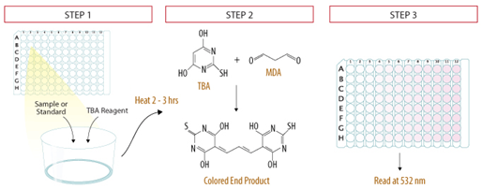
Effect on oxidative stress?
Experimental exposition of Lasius workers to « ecological » doses of DEHP
Measures of the malondialedehyde (MDA) levels in ants, as an index of lipid peroxidation and oxidative stress (TBARs assay)
3 different colonies
3 conditions: control, methanol, 2ng of DEHP diluted in methanol
2 time points: 24h and 48h after chemical exposition
10 pools of 15 workers per time, condition and colony
Notes:
Pools of 15 frozen ants were homogenized with kontes® microtube pellet pestle® in a buffer containing 100 mM KH2PO4, 0.05% BSA, 10 mM EDTA, 0.13 mM butylated hydroxytoluene and 0.13 mM deferoxamine (pH 7.4). Ant lipid peroxides content was assessed spectrophotometrically at 540 nm, measuring the malondialedehyde (MDA) as an index of thiobarbituric acid-reactive products (TBARs) following the method described by Ohkawa et al. (1979). Results are expressed in nmol MDA/mg protein of ants. Protein concentrations in pool of ants were measured according to Bradford method.

Slide 18
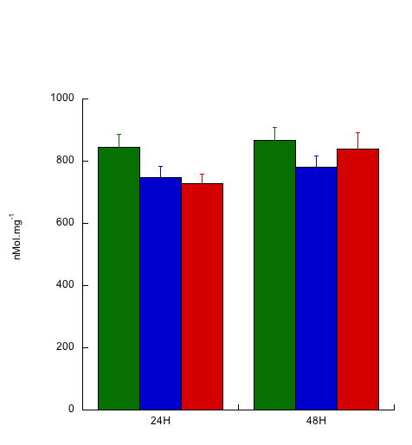








Effect on oxidative stress?
control
methanol
DEHP
No oxidative stress induced by DEHP treatment after 24 or 48h
24h
3 days
7 days
Fat body
Whole body
Whole body
Whole body
MetOH
DEHP
MetOH
DEHP
MetOH
DEHP
MetOH
DEHP
SOD1
No induction of SOD1 expression
16S
Notes:
Le DEHP n’induit pas de stress oxydatif contrairement à ce qui est décrit dans la biblio
Confirmé par l’absence d’induction de l’expression de la superoxyde dismutase 1 à court et moyen terme : enzyme qui participe normalement au contrôle du stress oxydatif intracellulaire (induite en cas de dégâts oxydatifs)
Hyp : 1- Dose trop faible par rapport aux autres études ?
2- les procédés à l’origine de la dynamique cuticulaire permettent de neutraliser le DEHP avant qu’il n’atteignent les tissus internes
In line with this unexpected result, the level of expression of SOD1 (superoxide dismutase 1), is only slightly affected by the phthalate treatment on short (24h) and midterm (3-7d; Figure 3). SOD1 is an intracellular copper–zinc superoxide dismutase that plays a crucial role in the control of oxidative stress in eukaryotic cells.

Slide 19
Detection of the chemical agression?
Experimental exposition of Lasius workers to « ecological » doses of phthalates (2ng)
2 phthalates tested: DEHP and BBP / control = methanol only
3 time points: 24h, 3 days and 7 days
Measures on the whole body or on the dissected fat body (± ovaries)
RNA extraction and semi-quantitative RT-PCR on pools of 15-20 Lasius workers to assess the relative expression of selected target genes
PGRP is a pattern recognition receptor that binds the peptidoglycans of bacterial cell walls
Defensin is an antimicrobial peptide that disrupts the bacterial cytoplasmic membrane
Histone 2A (H2A) may have an evolutionarily conserved role in innate immune defense
Vitellogenin (Vg) also have important function in the immune system in social insects
Notes:
RT-PCR sur des pools de 15-20 ouvrières par condition. 3 réplicats (sur 3 colonies différentes)

Slide 20
















Detection of the chemical agression?
24h
3 days
7 days
Fat body
Whole body
Whole body
Whole body
MetOH
DEHP
BBP
MetOH
DEHP
BBP
MetOH
DEHP
BBP
MetOH
DEHP
BBP
PGRP
Def
Vg
H2A
16S
PGRP is a pattern recognition receptor that binds the peptidoglycans of bacterial cell walls
Defensin is an antimicrobial peptide that disrupts the bacterial cytoplasmic membrane
Histone 2A (H2A) may have an evolutionarily conserved role in innate immune defense
Vitellogenin (Vg) also have important function in the immune system in social insects
↑ 24h

Slide 21
Detection of the chemical agression?
24h
3 days
7 days
Fat body
Whole body
Whole body
Whole body
MetOH
DEHP
BBP
MetOH
DEHP
BBP
MetOH
DEHP
BBP
MetOH
DEHP
BBP
PGRP
Def
Vg
H2A
16S
↑ 24h and 3d
↑↑ 7d
PGRP is a pattern recognition receptor that binds the peptidoglycans of bacterial cell walls
Defensin is an antimicrobial peptide that disrupts the bacterial cytoplasmic membrane
Histone 2A (H2A) may have an evolutionarily conserved role in innate immune defense
Vitellogenin (Vg) also have important function in the immune system in social insects

Slide 22
Detection of the chemical agression?
24h
3 days
7 days
Fat body
Whole body
Whole body
Whole body
MetOH
DEHP
BBP
MetOH
DEHP
BBP
MetOH
DEHP
BBP
MetOH
DEHP
BBP
PGRP
Def
Vg
H2A
16S
PGRP is a pattern recognition receptor that binds the peptidoglycans of bacterial cell walls
Defensin is an antimicrobial peptide that disrupts the bacterial cytoplasmic membrane
Histone 2A (H2A) may have an evolutionarily conserved role in innate immune defense
Vitellogenin (Vg) also have important function in the immune system in social insects
↑↑ 24h, ↑ 3d

Slide 23
Detection of the chemical agression?
24h
3 days
7 days
Fat body
Whole body
Whole body
Whole body
MetOH
DEHP
BBP
MetOH
DEHP
BBP
MetOH
DEHP
BBP
MetOH
DEHP
BBP
PGRP
Def
Vg
H2A
16S
PGRP is a pattern recognition receptor that binds the peptidoglycans of bacterial cell walls
Defensin is an antimicrobial peptide that disrupts the bacterial cytoplasmic membrane
Histone 2A (H2A) may have an evolutionarily conserved role in innate immune defense
Vitellogenin (Vg) also have important function in the immune system in social insects
↑↑ 24h, ↑ 3d

Slide 24
Detection of the chemical agression?
24h
3 days
7 days
Fat body
Whole body
Whole body
Whole body
MetOH
DEHP
BBP
MetOH
DEHP
BBP
MetOH
DEHP
BBP
MetOH
DEHP
BBP
PGRP
Def
Vg
H2A
16S
↑ 24h and 3d
↑↑ 7d
PGRP is a pattern recognition receptor that binds the peptidoglycans of bacterial cell walls
Defensin is an antimicrobial peptide that disrupts the bacterial cytoplasmic membrane
Histone 2A (H2A) may have an evolutionarily conserved role in innate immune defense
Vitellogenin (Vg) also have important function in the immune system in social insects
↑ 24h
↑↑ 24h, ↑ 3d
↑↑ 24h, ↑ 3d
Activation of the immune system

Slide 25
Summary
Ants suffer a chronic exposition to low doses of phthalates, mainly DEHP, DBP and DiBP
A part of phthalates adsorbed onto the cuticle is actively removed (metabolized ?) by the ant
The « ecological dose » that remain on the cuticle is enough to perturb ant’s physiology: DEHP induces a decline in queen fertility and an activation of the immune system, without detectable oxidative stress

Slide 26
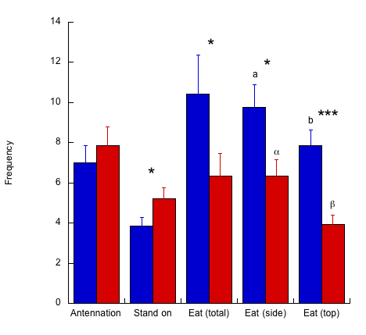
Consequences of such a large scale and chronic contamination on wild ants populations?
Over the reproductive output of colonies?
Over the immuno-competence of individual ants?
Over the social interactions based on cuticular compounds
methanol
DEHP
Foragers of Lasius niger detect and avoid contaminated food

Slide 27

Acknowledgments
Alain Lenoir
Karine Salin
Séverine Devers
Pauline Schaffner
Axel Touchard
Jean-Philippe Christidès
Frédéric Montigny
Raphaël Boulay
Sylvain Billiard
Merci de votre attention

